Slide 1
KINDNESS TO THE ANIMALS
AN ISLAMIC PERSPECTIVE

Slide 2
ALL PRAISES TO ALLAH ALMIGHTY
All praise is due to Allah, we praise Him, we seek
His help, and we seek His forgiveness. We seek
refuge with Allah from the evils of our souls and
the wrongdoings of our actions. Whomever Allah
guides, there is no one to lead him astray, and
whomever He leaves astray, there is no one to
guide him.
I testify that there is none worthy of worship
except Allah, Who is alone having no partner,
And that Muhammad is His servant and
Messenger.

Slide 3
Basic Guidelines:
Islam is the religion for all creatures. Our religion teaches us to be kind to animals.
The Muslim who has complete Eemaan (Faith) is the one who is kind to animals, and he does not harm them, nor hurt them. He does not prevent the animals from food and water.
The animals do not speak and they are not able to
complain to us. Because of this Islam encourages us to be kind to animals.
Islam has made a great reward for kindness to animals.

Slide 4
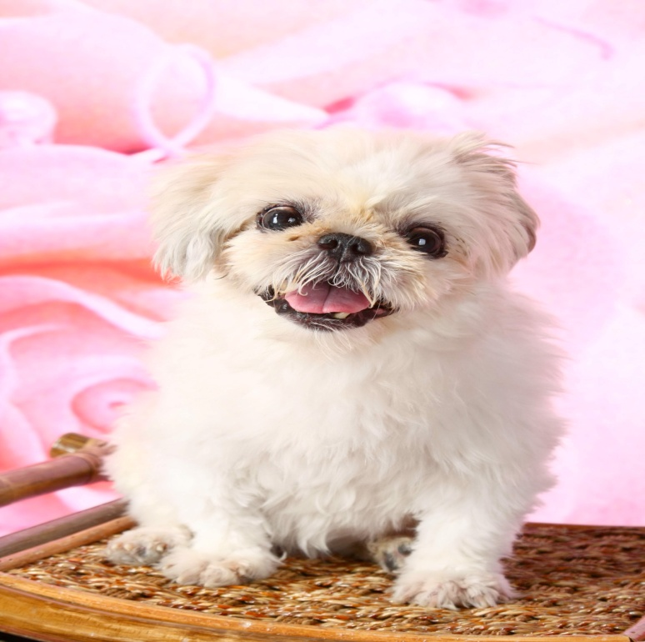
Statistics about pets in HK
As of year 2006,
286,300 households in Hong Kong kept
pets, of which
48.4%
Were dogs

Slide 5
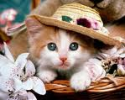
22.3%
cats

Slide 6
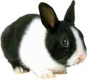
29.3%
Other pets such as:
Rabbits and
Tortoises

Slide 7
Animal Welfare Laws: Seriously Outdated
Study finds 75 years old anti-cruelty
legislation leaves pets without adequate
protection.
Licensed dogs:
2000: 67,098
2009: 317,024

Slide 8
Pets Living Conditions in HK
Reptiles kept in cartoons the
size of a lunch box;
Dogs in cages where they can
barely turn around.
Tortoises piled in buckets with
no where to climb out and get
dry.

Slide 9
Associate professor of law Amanda Whitfort
says:
The government has yet to set minimum legal
cage sizes for pet shops that keep animals but are not involved in breeding.
As long as the animals can ‘move freely’ in a cage the operators will not be prosecuted.

Slide 10
Whereas in Australia, the government has set
minimum legal cage sizes for specific animals species
such as dogs, cats and rabbits.
The law also forbids shops from keeping pets for
more than four weeks.

Slide 11
Yet in HK, animal traders are free to keep
pets for as long as they want.
They are also not required to walk the
dogs they keep for sale.

Slide 12
Even if a trader is convicted of an animal
cruelty offence, the Agricultural, Fisheries
and Conservation Department does not
have the power to revoke the license.
Also, the researchers point out, no major
updates have been made to the Prevention
of Cruelty to Animals Ordinance since it
was enacted 7 decades ago.

Slide 13
Current Situation
Professor Whitfort says:
Currently an animal which has not suffered
an overt act of cruelty cannot be assisted.
Authorities must stand by and wait for the
animal’s situation to deteriorate to the level
of prosecutable cruelty before they can do
anything.

Slide 14
Tony Ho Tse-tong says:
(Chief Superintendent of the Society for the Prevention
of Cruelty to Animals’ inspectorate team)
It is not possible for animals groups to help
animals at risk unless they show clear signs
of illness.

Slide 15
According to Agricultural, Fisheries
and Conservation Department:
Government authorities received 157
reports of animal abuse last year.
9 people were prosecuted.

Slide 16
Veterinarian Dr Pauline Taylor describes:
The legal protection for animal welfare in
HK as ‘very basic’, even though it had
made some progress.
Pet shops were only required to provide
space for an animal to stand in and turn
around, and there were inadequate resources to check on pet shops.

Slide 17
IN HONG KONG | IN SINGAPORE
Prevention of Cruelty to Animals Ordinance is based on Britain’s Protection of animals Act 1911 (which in the UK has been replaced with a new law enacted in 2006) | The animals and Birds Act 2002 is a comprehensive law that covers animal welfare, licensing of pet shops, regulation of veterinary clinics, importation of animals and the management of livestock.

Slide 18
* Enacted in1935 | * Enacted in 1965, but has been revised in 1970, 1985 and 2002.
Definition of cruelty outdated | Clearly defines acts of cruelty under eight Sub-clauses

Slide 19
Penalty (HK) | Penalty (SP)
In 2006, HK$5,000 fine and six months’ jail increased to HK$200,000 fine and three years’ jail | If found guilty, a person faces a fine of not more than S$10,000 (HK$56,000) or imprisonment not exceeding 12 months, or both.

Slide 20
Basic Islamic Guidelines
Come with me and let us learn the
guidance of Islam concerning kindness to
animals so that we may behave with this
beautiful character and gain the abundant
reward of Allah.
I ask Allah to benefit us with this piece of
presentation.

Slide 21
Kindness to Animals: The Greatness of Islam
Sa’eed bin Jubayr (May God be pleased with him) tells us:
I was with Ibn ‘Umar(May God be pleased
with him) when he passed by a group of
boys who had tied up a chicken and set it
up in order to shoot at it (as a target).
When they saw Ibn ‘Umar (May God be pleased with him)
coming, they ran away and left the chicken.

Slide 22
Ibn ‘Umar (May God be pleased with him) said:
“Who did this?
The Prophet cursed whoever uses animals for targets.”
This means that the animal should not be made
a target of torture. Torture may be inflicted by
cutting off the animal’s limbs, or some of its parts
while it is still alive. This is strictly forbidden in
Islam.

Slide 23
Islam is the religion of mercy for all creatures
Mercy for:
Humans
Animals
Birds
Plants
All That Exists

Slide 24
Attitude Towards Animals
Do not torment the animals
Do not prevent them from food and
drink
Do not make them the object of shooting (or throwing).
Treat them well with gentleness

Slide 25
Islam is the call of mercy
If the person knows that he would be cursed for
tormenting animals, then how about when he torments
human beings? Truly, Islam is the call of mercy. Our
Lord is the Most Gracious, the Most Merciful.
Our Messenger Muhammad is the Prophet of mercy.
Our religion is the religion of mercy.
We ask Allah, the Most High, to make us of those who
are merciful.

Slide 26
Salaf As-Saalih (The Earlier Pious Generations) advised to be Kind to Animals
Caliph ‘Umar (May God be pleased with him) saw a man pulling
a sheep with his leg in order to slaughter it.
Caliph ‘Umar (May God bepleased with him) said to him:
“Woe to you. Take it to its place of slaughtering in a good manner.”
Look at this compassion for animals, even at the
time of slaughtering.

Slide 27
Adi Bin Haatim’s Kindness to Ants
What did ‘Adi bin Haatim(May god be
pleased with him) used to do whenever
there were any bread crumbs remaining
after a meal? He would collect whatever
bread was left and give it to the ants that were
walking on the wall outside of his house.
When he was asked about his action he would
say:
“They are my neighbors! They have a right upon me!”

Slide 28
Kindness to Animals is a Beloved Characteristic
Whoever is kind to animals, he is loved by the Most Gracious.
Kindness to animals is a beloved characteristic for every person.
If Allah, the Most High, loves anyone, He gives him kindness in all of his affairs.
Allah loves kindness to people and Allah loves kindness to animals.
Allah loves kindness with friends and Allah loves kindness with neighbours.
Allah, the Most High, loves gentleness in dealing with animals. Whoever is kind to animals, the Most Gracious (Allah) is pleased with him.

Slide 29
Saying of The Holy Prophet (PBUH)
‘Hazrat Aishah (May God be pleased with her) the Mother of the Believers, said that she heard the Messenger of Allah saying:
“Allah loves kindness in all matters.”

Slide 30
Caliph ‘Umar (May God be pleased with him) worries about a Mule
Our earlier pious generations used to worry about
their shortcomings in the Rights of Allah, the Most
High.
They used to worry about their shortcomings in the rights of others.
They did this whether it was with their
Family
Relatives
Neighbours
Friends

Slide 31
One of them even worried about his shortcoming in giving a riding animal its rights.
One day Caliph ‘Umar (May God be pleased with him)
gathered the people and said to them.
“O people, by Allah, I fear that if a mule stumbled on the shores
of Iraq, I will be held accountable by Allah concerning it on the
Day of Judgement.”

Slide 32
What did Caliph ‘Umar (May God be pleased with him) want to teach us?
He wants to teach us to:
not fall short in giving the rights to animals and birds
Give them food and drink.
Let him treat it with gentleness and kindness.
“Animals and birds have rights upon us. So, we
have to treat them with gentleness and kindness.”

Slide 33
The Man and the Thirsty Dog
The Companion, Abu Hurairah(May God be pleased with him) tells us
that he heard:
“Once a man was walking along the road when he was overcome by
extreme thirst. He found a well, so he climbed down into the well
and drank. Then he came out to find a dog that was painting with
thirst. The dog was so thirsty that it was eating mud from the
ground.”
The man thought that this dog was feeling the same type of thirst that
he had. Thus, he went down into the well again and filled his leather
sock with water. Then he held it in his mouth so that he could climb
back up the well. Then he gave it to the dog to drink.

Slide 34
Act of Kindness: Forgiveness of Sins
He held the shoe between his teeth until he came up
out of the well. Then he placed the water down in
front of the dog. The dog drank, and quenched its thirst.
O what a good man he was…
What happened after that?
“Allah appreciated his act and He forgave him
(of his sins).”
This means that Allah accepted his deed and had mercy upon
him.

Slide 35
The Companions of the Messenger of Allah asked:
“O Messenger of Allah, is there reward
for us (from Allah) in animals? Are we
rewarded for treating animals well?”
The Prophet (PBUH) said:
“In every tender heart, there is a reward.”

Slide 36
Do Not Torment Animals
Islam commands us to be kind to animals
Islam forbids us from tormenting animals.
The righteous Muslim is kind to animals and stays away from tormenting them.
Therefore if any of us see someone who has tied up
an animal by its neck, and the rope is choking it and
causing it pain, then say to him:
“Do not torment animals.”

Slide 37
Do not torment animals
If you see someone who keeps an animal
locked up, and he does not give it water,
then say to him:
“Do not torment animals.”
If you see someone beating an animal, or
throwing rocks at it, then say to him,
“Do not torment animals.”

Slide 38
Kindness to The Birds
The Companion, Abdullah bin Umar (May God be pleased with
him), passed by some boys who had tied up a bird and they
were shooting at it. They had bound and fettered it, and then
they started shooting their arrows at it. Then they would
blame the owner of the bird for every miss of their arrows.
But when they saw Ibn Umar (May God be pleased with him),
they fled in fear of his anger. Ibn Umar (May God be pleased
with him) said:
“Who did this? May Allah curse whoever did this.
The Messenger of Allah cursed whoever used as a target
something that has a soul in it.”

Slide 39
Kindness to Animals while Slaughtering
Meat is from the food of human beings and it is one of the most delicious foods to man. Meat comes from some of the animals, like cows and sheep.
Our Islamic religion teaches us to be kind to animals even when we want to slaughter them.
We do not slaughter the animals in front of their young, out of kindness to the animal and its young.
Also, out of compassion for it, we do not slaughter the animal in front of its face where it may see the knife.
We do not drag it away forcefully to the place of slaughter. Rather, we lead it in a kind manner.

Slide 40
Kindness to Animals while Slaughtering
We do not slaughter it with a dull knife. Rather we sharpen the knife in order to lessen its pain.
The Prophet (PBUH) says:
“Verily Allah has prescribed perfection upon everything.
Therefore, when you kill (slaughter an animal), then do
it well. Let each of you sharpen his blade and be gentle
with his animal (during the slaughtering).”
(Muslim)

Slide 41
The Beauty of Islam
Are there any teachings better than Islam?
It teaches us to be kind to animals before slaughtering.
Our religion is great.
Caliph ‘Umar (May God be pleased with him), used to forbid that a sheep be slaughtered in the presence of another sheep.

Slide 42
Why is that?
This is so that the one whose turn to be slaughtered has not come will not be disturbed. Also, this is so that you do not frighten the one that is being prepared for slaughter.
It has been mentioned that ‘Umar (May God be pleased with him) , saw a man dragging a sheep in order to slaughter it and he struck it in its breast. ‘Umar (May God be pleased with him), said to him:
“Woe to you. Take it to its slaughter place in a kind manner.”
“We should show kindness to animals at the time of slaughtering.”

Slide 43
The Cat and the Mean Woman
The Companion, Ibn ‘Umar (May God be pleased with him), tells us that the Messenger of Allah said:
“A woman entered the Hell-fire because of a cat.”
But why did this woman go to Hell? What did she do to the
cat? Let us listen to the Messenger of Allah as he relates this
story to us:
“She locked it up and bound it in fetters. She would not feed it, nor
give it drink. Also, she would not let it eat the vermin of the earth.”
The vermin are the insects and rodents. Thus, what happened to the
cat after its imprisonment and prevention from food and drink?

Slide 44
The Messenger of Allah said:
“…until the cat died. Therefore the woman
entered the Hell-fire because of it.” The woman’s
heart had become extremely hard. The cat died
because of her preventing it from food and drink.
Therefore, this woman deserved to enter the
Hell-fire because of this.
In this story there is a good lesson for us.
“We must refrain from harming animals.”

Slide 45
The Story of Prophet and an Ant
Do you know about the story of the Prophets
whom Allah scolded for killing ants?
The Companion Abu Hurairah(May God be pleased
with him) tells us about it. He said:
“The Messenger of Allah told us one day that
one of the Prophets sat down under a tree.” This was so that he could rest from the fatigue of
his travel and seek shade under the tree. Then what
happened to that Prophet?
“An ant bit him.”

Slide 46
What did the Prophet do to it?
“He commanded that his articles be moved and he removed everything from under the tree!” This means that the Prophet commanded the people to remove his belongings from their place under the tree.
“Then he commanded that the ant’s home be burnt.” When he burnt the home of the ants and their place of living, Allah revealed to him: “Is it because of the bite of a single ant that you have destroyed an entire nation from the nations that glorify (Allah)! Why not just kill one ant?”

Slide 47
A light scolding to Prophet
This means:
“Why did you not just burn one ant – the ant that harmed you – instead of all of the others?”
The others did not commit any crime. In this was a light scolding from our Merciful Lord upon His Noble Prophet.

Slide 48
From this Prophetic story we learn the following:
That the animals really glorify Allah, the Most High.
That it is not permissible to burn animals with fire.
That Allah, the Most High, was concerned about the ants that no one cares about, in order that we may learn kindness to animals.

Slide 49
The Holy Quran Says:
“See you not (O Muhammad PBUH)” that Allah, He it is Whom glorify whosoever is in the heavens and the earth, and the birds with wings outspread (in their flight)? Of each one He (Allah) knows indeed his Salat (prayer) and his glorification [or everyone knows his Salat (prayer) and his glorification]; and Allah is All-Aware of what they do. (An-Nur 24:41)

Slide 50
The Story of a Sad Camel
Do you know the story of the sad camel ?
A camel was sad, because the owners
wanted to slaughter it. What did the camel
do? We will let the Companion, Ya’la bin
Murrah (May God be pleased with him), tell
us the story from its beginning.

Slide 51
The story begins:
He said:
I travelled with the Messenger of Allah and I saw
something from his that was amazing. We stopped
at a place, when a camel came to Him and stood in
front of Him. The Messenger of Allah saw that its
eyes were flowing with tears, so he sent for its
owners and said to them:
“What is with this camel of yours that it complains
about you?”

Slide 52
His Companions said:
“We used it for our work, but now that it has grown
old and it cannot work, we have decided to slaughter it
tomorrow.”
This means that they had agreed to have it slaughtered.
The Messenger of Allah said:
“Do not slaughter it. Place it with the other camels so it can be with
them.”
Ya’la (May God be pleased with him) then said:
“So he branded the camel with the mark of charity and let it go
(amongst the others).”

Slide 53
The tradition had been reported with more detail saying that the Prophet said:
“Where is the owner of this camel?”
The owner came and the Prophet said to him:
“Sell it to me.”
The owner said:
“No, rather we will give it to you as a gift, O
Messenger of Allah.”
In other words, “I am giving it to you as a gift from me.”

Slide 54
The Prophet then said:
“No, sell it to me.”
The owner replied:
“No, rather we will give it to you, O Messenger of Allah. It
belongs to a family of a household that does not have any
livelihood other than it.”
The Prophet said:
“I have only mentioned this about its affair (i.e., buying it)
because it is complaining of too much work and very little
feeding. Therefore be good to it.”

Slide 55
Moral Lesson:
This story teaches us the extreme mercy of the Messenger of Allah towards animals.
His kindness to them.
We follow the Messenger and imitate his deeds. For this reason we must be kind to animals.
“Our Prophet Muhammad (PBUH) was extremely merciful and kind towards animals.”

Slide 56
Conclusion:
My beloved Islamic Course participants…
Kindness to animals is something that Islam teaches us.
We obey and listen to everything that is in our great religion of Islam.
We must not torment animals, but rather we should be kind and merciful to them.
We must not forbid them from food and water, but rather we should feed them and give them drink.
We must not harm them by beating them or dragging them forcefully.
If we do these things, then we will have established kindness to animals.

